Slide 1
Harry Mangalam Research Computing
OIT / UCI

Slide 2
I am a continually Dissatisfied User.

Slide 3
My Drivers
How to provide the maximum benefit to researchers.
As Easily as possible (for them).
As Quickly as possible.
As Cheaply as possible.
Using mostly (GRAM) Open Source Software.

Slide 4
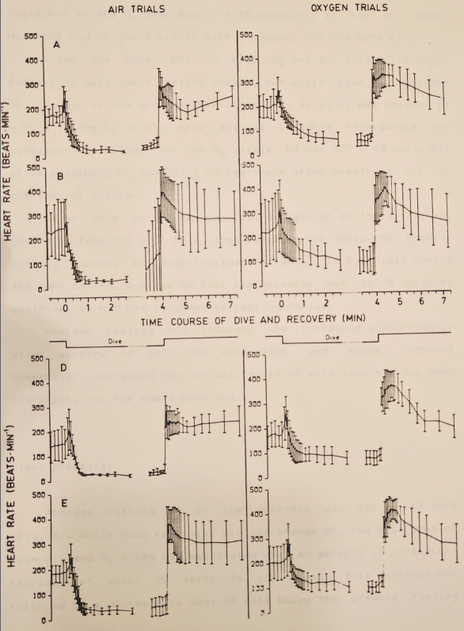
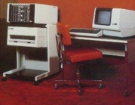
Education
BSc & MSc [UBC] Comparative Physiology
  DEC MINC-11 Lab computer
  Peak Detection, Plotting
  Software in Fortran
PhD [UCSD] Gene Transcription & MolBio
  Interests in programming
PostDoc [Salk Inst] Fly Genetics
  Mac, Windows, VAX, SGI, Linux, programming C, Internet, Gopher, Bio DBs, WAIS Indexing info

Slide 5
Other Background
NCGR: GeneX
Independent Software Developer
Acero: Commercial Object DB
UCI/ESS: profiling optimizing code, how SW works.

Slide 6
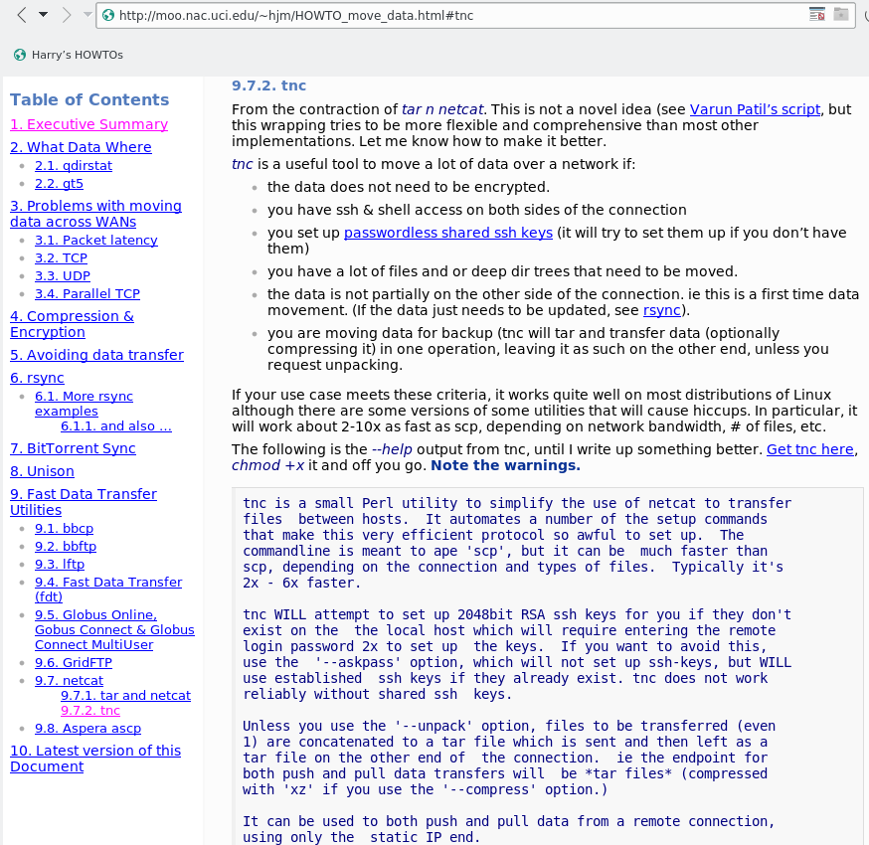
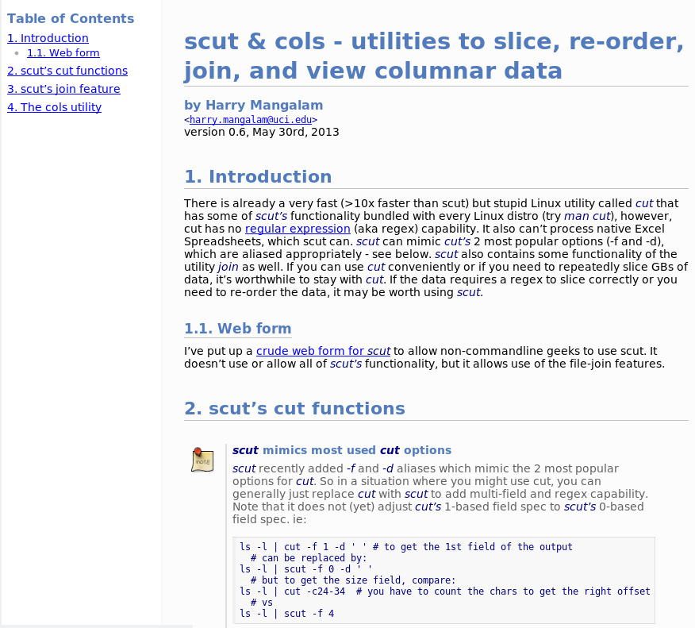
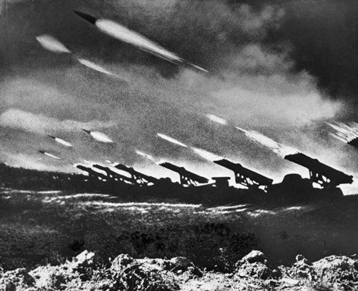
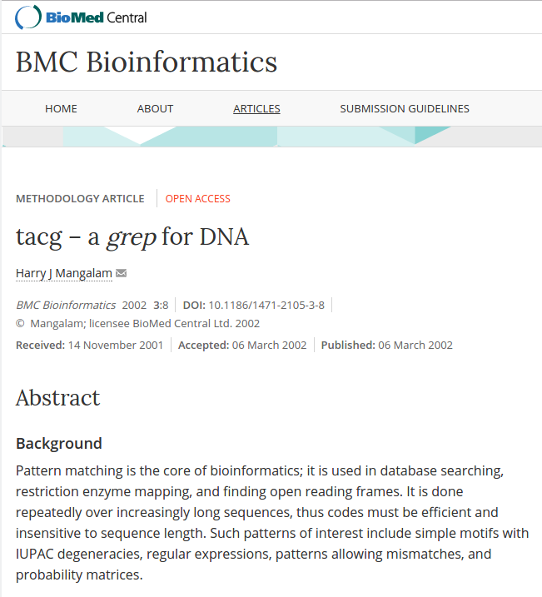
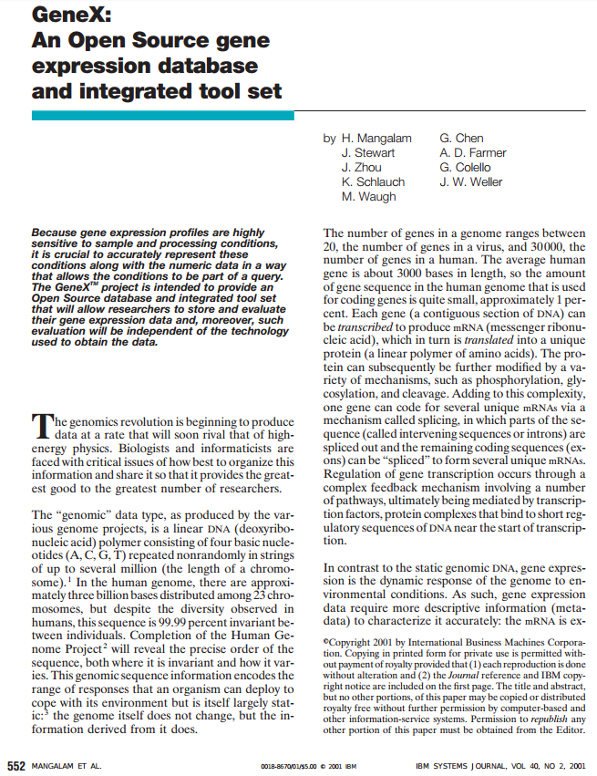
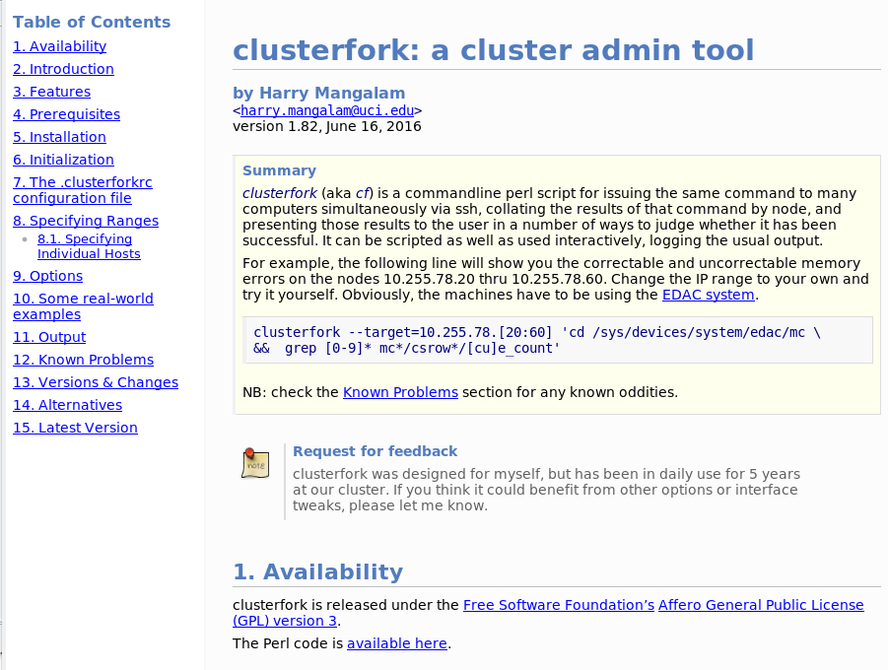
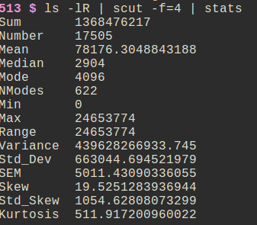
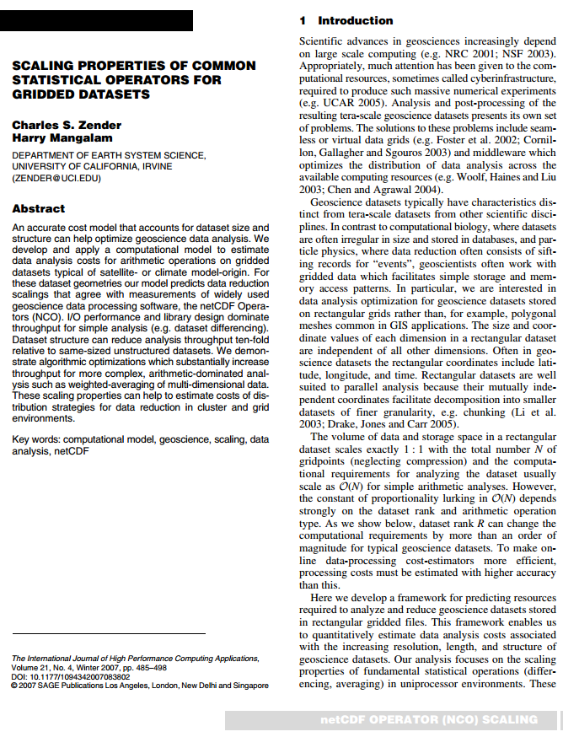
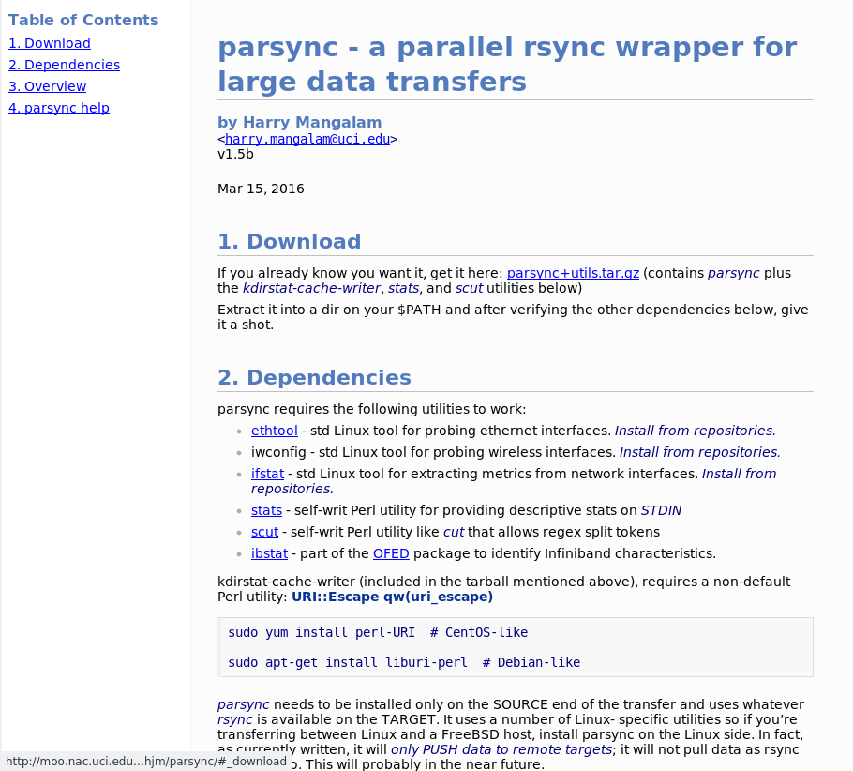
Software
tacg*
GeneX*
nco profiling*
clusterfork
scut, cols, stats
parsync – self-regulating parallel rsync
tnc – tar ‘n’ netcat
katyusha (current) – self-tuning, parallel
data transfer

Slide 7


Invited talks
Basel Life Sciences (2016)
  Title: Storage for Inforgs
Supercomputing16
  Title: BeeGFS in real life (BigData BOF)

Slide 8
Previous Grants
Salk Institute [MRC]: Postdoctoral Fellowship
UCI School of Medicine: [Pacific Bell/CalREN]:
  Telemedicine over ATM
  1st MBONE telecast from LBVA.
NCGR: [NSF] GeneX

Slide 9
OIT Grant & Dev Efforts
Equipment Donations: [TGMS, HGST]
  QDR IB enterprise switch, 4 tape robots, multiple large servers, 7 racks of compute servers, NVME cards
OIT: [NSF] Cyberinfrastructure Engineer
  Joulien!
OIT: [UCI] RCIC Proposal

Slide 10
Documentation Examples
Cyberinfrastructure
  UC Irvine CyberInfrastructure Plan - 2013
  A Model Outline for Research Computing
  How to move data.*
  The Storage Brick:
  Fast, Cheap, Reliable Terabytes
  The Perceus Provisioning System
  Distributed Filesystems: Fraunhofer vs Gluster

Slide 11
Teaching / Instruction
BigData Hints for Newbies
BigData on Linux (Data Science slides)
Introducing Linux on HPC (PDF Slides)
A Linux Tutorial for HPC
Manipulating Data on Linux

Slide 12
Open Source Software
How to Evaluate Open Source Software
Open Source and Proprietary approaches in Municipal Information Technology.
Setting up an LTSP Thin Client System
Mind Your NegaBit$

Slide 13
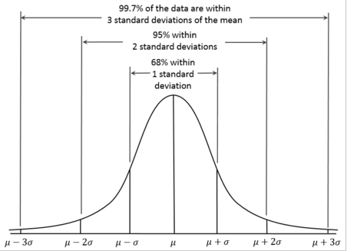
Do I fit with UCI?
Academic, Non-Profit, Solo, & Commercial experience
Improvements from the User’s Perspective.
‘4 Σ’ approach vs only the top end.
‘Catalytic Programming’.
Some familiarity with UCI.
Demonstrated strengths
in critical areas, especially
grants and hardware.

Slide 14
Immediate Priorities
Hiring good people, esp at PA 1&2, students
Optimize how the RCIC budget is allocated and spent.
Change responsibilities; higher PAs addressing appro tasks.
  re-architecting clusters, schedulers, overall integration
  assisting with code porting, profiling, optimization
  addressing research sysadmin problems (w/ EUS)
Aggressive outreach to UCI Faculty, Depts
  Meeting with Senior Leaders for 10m intro to RCIC
Grants applications, coordinated with faculty, Public & Private
Campus Storage Pool.
‘Data Days’ – 2 headliners, lightning talks, panels, prizes.

Slide 15
Coming Challenges
Secure Computing
Continuous review of new technologies:
  Flash, Xpoint memory
  Omnipath, >10GbE
  FPGAs, GPUs, new CPU arch’s
  Filesystems
  Containers for apps & analysis provenance
  cloud technologies
Better Coordination with other UCs

Slide 16
More Challenges
Assuring and expanding RCIC funding..
RCIC should expand in the following ways:
  More computation, at least 2x current cores
  More and faster storage, esp hybrid/flash
  More usable network services
  more secure networking via cheaper, faster defenses.
  More direct assistance & involvement with researchers

Slide 17
Good Judgment comes
from Experience.
Experience comes
from Bad Judgment.

Slide 18
Questions?

Slide 19
Appendix Slides

Slide 20
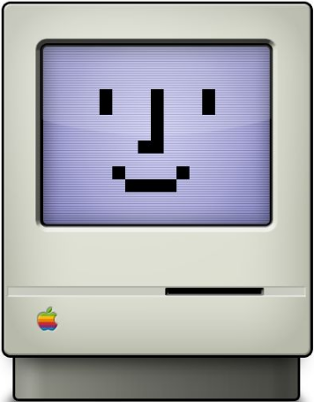

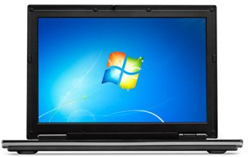
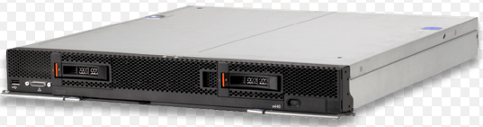



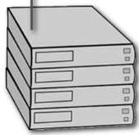
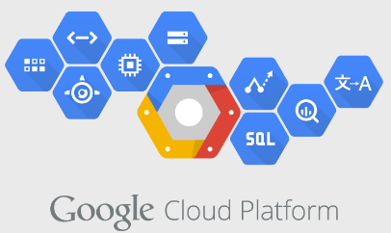
UCI Campus Storage Pool
// Filesystems
optimized for..
Firewall
I/O Nodes
(// Clients)
SMB
DFS1: Hi IOPS on SSDs
NFS
DFS2: BigData streaming RW
on large spinners
Web
Science DMZ:
rclone, GridFTP
Erasure-
coded
Archive
Compute Clusters – each node in the cluster can be a // client if needed.
DFS3: Sensitive data on a protected, encrypted FS
Notes:
This diagram shows how we are planning to provide a 'Campus Storage Pool' for the entire university. This approach is being done by a number of orgs including UCLA and Purdue, but in different ways.
Our system feeds the same clients (tho Cloud clients are now also added), as well as several layers of firewalls and ACLs (red line). The protocol-specific servers are still represented, but they will often be serving multiple protocols simultaneously.
The largest difference is that the back end storage is made of multiple // DistFS, each available to all the data servers / consumers, not only the IO Nodes, but also directly accessible to our compute clusters (and every node in the compute cluster can have // access to the DistFS.
The DistFS can be optimized for different IO requirements, Hi IOPS on SSDs, BigData on spinners, and especially different security profiles to provide much more secure environments if nec (pink rect indicates special security around a HIPAA-secure DistFS.)

Slide 21
Back End
// Filesystems
optimized for..
rclone, web
DFS1: Hi IOPS on SSDs
HGST AA?
Ceph?
DDN WOS? LizardFS?
MozoFS?
DFS2: BigData streaming RW
on large spinners
Erasure-Coded,
Multi-tenant
Object Archives
DFS3: Sensitive data on a protected, encrypted FS
Notes:
The left part of the slide repeated here shows an archive/backup system that uses erasure encoding instead of RAID to provide resistance to failure. It's not the same as Backup, but it's a big move in that direction.
EC allows data integrity even during the loss of multiple chassis'.
The components of the archive system are distributed around campus and clustered via 10 or 40GbE.
Also note the blue arrows which indicate that the archive will initiate connections to the DistFSs, run the HSM software, then disconnect to decrease the likelihood of attack from outside.
Erasure is being used more frequently by vendors to provide more robust storage, tho sometime at the cost of write speed. However, alternative EC algorithms (Fountain, Mojette, others) have decreased the write penalty considerably.

